Slide 1
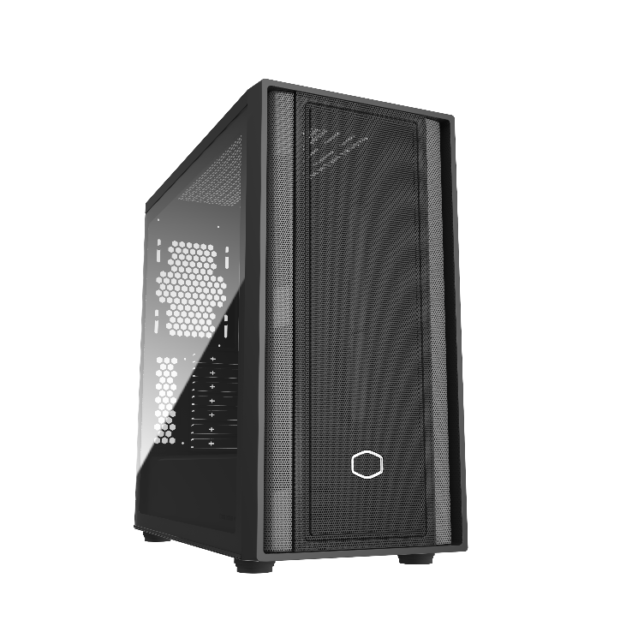
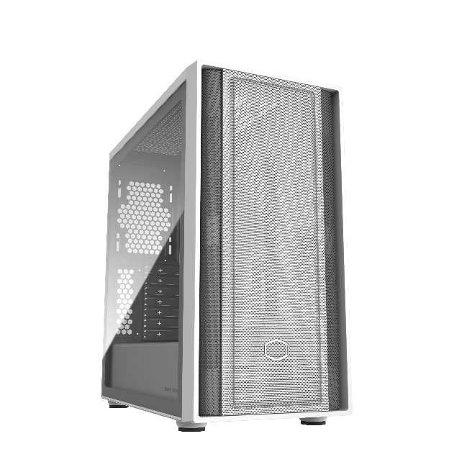
Powering Next Generation
The Masterbox 600 aims to bring high-level performance to every segment of the PC building community. We believe all users should be able to acheive the greatest heights of performance, so the Masterbox 600 is designed to deliver premium features and performance to te broadest user base possible.
The MasterBox 600 is prepared with space for a 420mm radiator and a 410mm GPU, back-connector motherboard support, which is the new standard for modern ATX cases.
MasterBox 600 Lite
MasterBox 600 White Lite
Back-connected motherboard support
Supporting back-connected motherboard to frees up space in the front of the case, providing 33-35mm space behind the motherboard tray for easier cable management.
Versatile Cooling Options
Support for up to seven 120mm fans and either a top-mounted 360mm radiator or a front-mounted 420mm radiator allows for hyper-effective CPU cooling.
FineMesh Performance Front Panel
Large mesh intakes offer unrestricted airflow and stellar thermals for demanding systems.
Removable HDD cage
The HDD cage is completely removable for improved access during assembly and system upgrades.
Room For Upgrades
With support for a 410mm GPU, a 170mm CPU cooler, and multiple fans and radiators, the MasterBox 600 will ensure you stay ahead of the game.

Slide 2
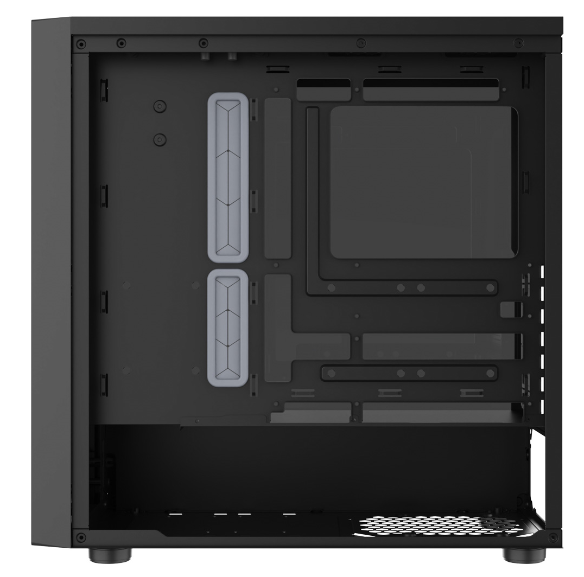
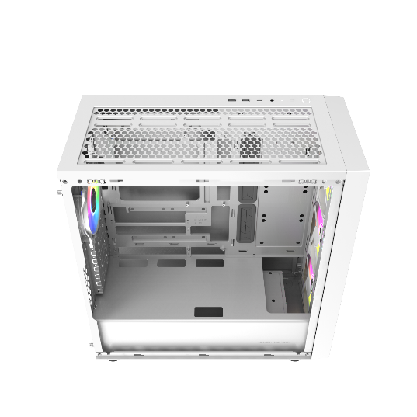
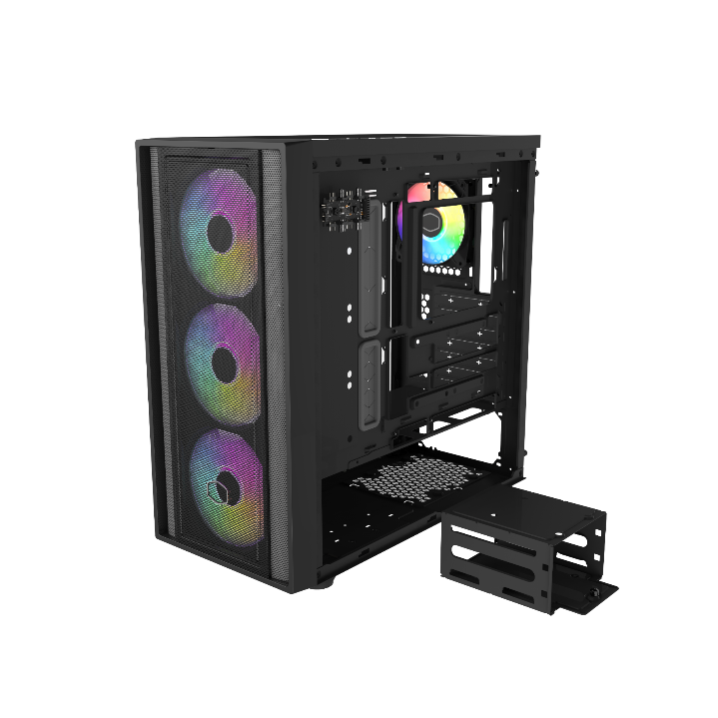
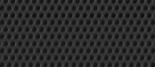
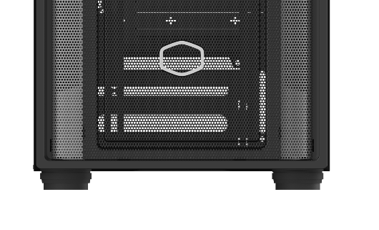
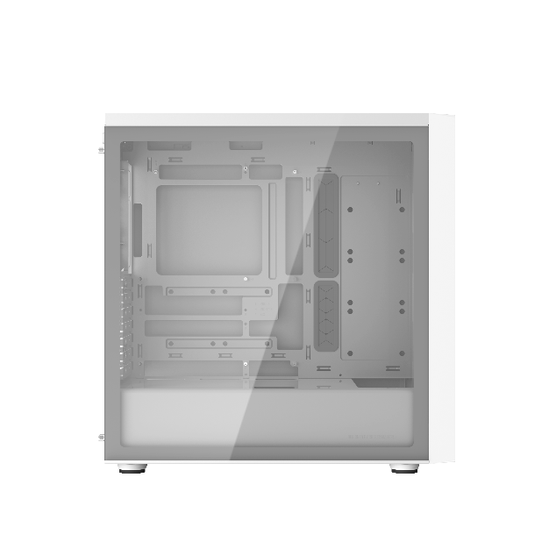
Up to 3x 120mm
1x 120mm
Up to 3x 140mm
Back-connected motherboard support
Supporting back-connected motherboard to frees up space in the front of the case, providing 33-35mm space behind the motherboard tray for easier cable management.
Versatile Cooling Options
Support for up to seven 120mm fans and either a top-mounted 360mm radiator or a front-mounted 420mm radiator allows for hyper-effective CPU cooling.
FineMesh Performance Front Panel
Large mesh intakes offer unrestricted airflow and stellar thermals for demanding systems.
Removable HDD cage
The HDD cage is completely removable for improved access during assembly and system upgrades.
Room For Upgrades
With support for a 410mm GPU, a 170mm CPU cooler, and multiple fans and radiators, the MasterBox 600 will ensure you stay ahead of the game.

Slide 3
Product Name |  | MasterBox 600 Lite | MasterBox 600 White Lite
Product Number |  | MB600L-KGNN-S00 | MB600L-WGNN-S00
Exterior Color |  | Black | White
Materials | Exterior | Steel, Plastic
 | Side Panel | Tempered Glass
Dimensions (L x W x H) | Incl. Protrusions | 474mm x 230mm x 481mm
 | Excl. Protrusions | 465mm x 230mm x 465mm
Volume (Liters Incl. Protrusions) |  | 49.73 L
Motherboard Support |  | ITX / Micro ATX / ATX (Supporting Back-connector Motherboard) / E-ATX (*up to 12"x10.9"/ 30.5cmx27.7cm motherboards, may impact cable management)
Expansion Slots |  | 7
Drive Bays | 5.25“ ODD | N/A
 | 3.5” HDD | 2
 | 2.5” SSD | 2 (Max.6)
I/O Panel | USB Ports | 1x USB 3.2 Gen1 Type A, 1x USB 3.2 Gen1 Type C
 | Audio In / Out | 1x 3.5mm Combo
Pre-installed Fan(s) | Front | N/A
 | Rear | N/A
Fan Support | Front | 3x 120 / 3x 140mm
 | Top | 3x 120mm / 2x 140mm
 | Rear | 1x 120mm
Radiator Support | Front | 120/140/240/280/360/420mm (Limit: 457*140*27mm)
 | Top | 120/140/240/280/360mm
 | Rear | 120mm
Clearances | CPU Cooler | 170 mm
 | Power Supply | 170mm, 210mm (w/o HDD Cage)
 | Graphics Card | 360mm, 410mm (w/o front radiator)
Cable Routing | Behind MB Tray | 33~35 mm
Dust Filters |  | Top/Bottom
Power Supply Support |  | ATX
Warranty |  | 2 years
EAN code | MB600L-KGNN-S00：4719512146897 MB600L-WGNN-S00：4719512146910
UPC code | MB600L-KGNN-S00：884102119217 MB600L-WGNN-S00：884102119231
Net weight (KG) | 6.9
Gross weight (KG) | 8.4
Carton dimension (L x W x H)mm | 547 x 315 x 554
Cont. | W/ Pallet | Carton/ Pallet | W/O Pallet
20’ | 240 | 20 | 296
40’ | 480 | 20 | 604
40 HQ | 576 | 24 | 688

